Slide 1
Collaboration between IT Departments
and Student Leadership
Conference on Higher Education Computing in Kansas
May 29 – 30, 2013

Slide 2
Meeting Student Expectations
Basic Student Outreach
Focused Student Outreach
Student Consultation Groups
New Student Orientation
Specific to various student groups
CIO lunch meetings with varying groups of students
Other venues
Pre-101
Participating in student forums
Maintaining a presence through social media
Such as the Student Senate and residence hall students groups
Hawk Week,
You at KU
International students
Graduate school
Notes:
Intro. A little bit about ITCC.
Outreach and consulting to departments and units, helping match up needs with services, finding new solutions
Outreach and consulting to faculty through our EdTechs, supporting them with teaching and learning tools.
Outreach and consulting through our Media Production staff, helping add media in curriculum.
Student outreach – explain each piece on slide
New CIO – Get in touch with student needs – Print from Anywhere (Papercut). Partner not a barrier. Relationship has improved 100%

Slide 3
Why mobile charging stations?
Student Senate election platform
The project was one of 12 different items on KUnited’s platform this past year.
The project was made a priority of IT’s because the idea came directly from the students.
Specific request from the Student Senate President and VP
“So many people live off campus and need to charge their phones. Students brought up the idea.” ― Hannah Bolton, Student Senate President
Notes:
What were the other platform issues.. How many were acted upon. Reach out to Hannah or

Slide 4
Getting the project started
Met with CIO Bob Lim for approval for IT funding
Opened a formal Project and invited representatives from The Union, The Libraries, Student Senate and IT
Goal – Install as many charging kiosks in as many public student commons areas as funding would allow
IT worked with the Student Senate to purchase and install 15 charging stations by the beginning of the Spring 2013 semester.
“Each year KU IT works with Student Senate to make sure technology is helping students meet their goals. We thought it sounded like a really good plan.”
― Ann Ermey, KU IT director of service management and delivery

Slide 5
Vetting vendors
We contacted three of the most popular vendors and received spec sheets from each
GoCharge
NV3
Kwik Boost
Options considered:
Size
Cost
Installation
Maintenance and delivery
Notes:
As we began to research the devices, it became apparent that cost was going to be a major factor. The costs were between $300 and $2,000.
List of other universities using charging stations. Quotes?
Penn State, Notre Dame etc. etc.

Slide 6
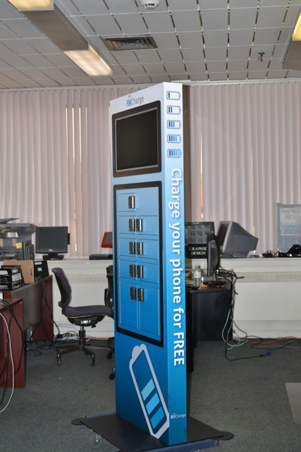
Note: It was determined that a lockable unit may open KU up to possible liability claims and the lockable units were not considered.
Notes:
The cost of the full size kiosks were approximately $2,000. One vendor was willing to give us a reduced price if we included advertising. The ads would be chosen by the vendor and they would receive the revenue.

Slide 7
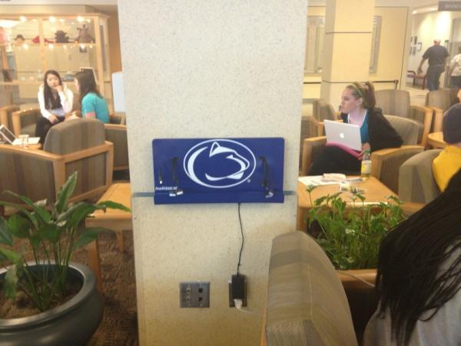
Small is sometimes better
This was the first picture that we saw of the smaller wall mount design (in use at Penn State).
Notes:
The more we though about cost/benefit ratio it became apparent, that for our needs at this time, the smaller device was the most practical solution.

Slide 8
About the devices
The charging station wall mount
9 Charger cords
iPhone (4 and 5)
Universal micro
Mini-USB
It also has a small platform for people to place their phones while charging
It will accommodate a tablet sized device

Slide 9
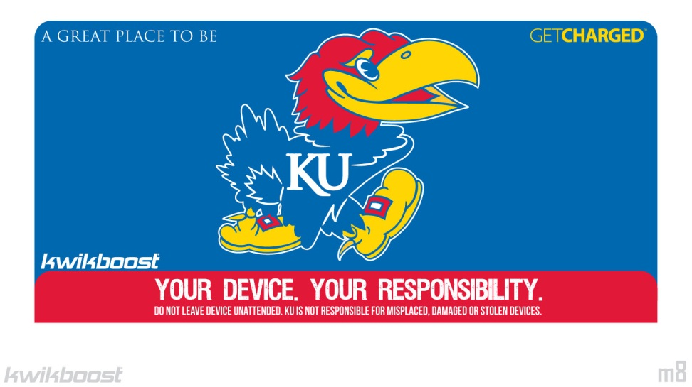
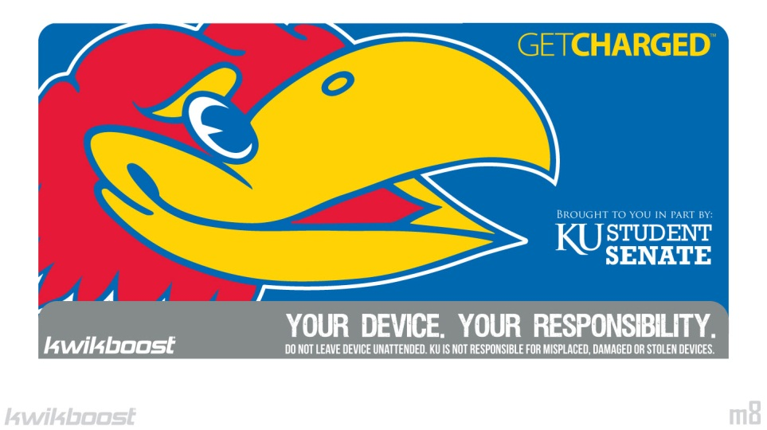
Initial designs
Notes:
This was the fun part. At first we really liked the large Jayhawk head but we had a problem. The charging cords come through the front plate and in this case it came through the Jayhawks eye. BTW, the design and printing was included in the cost.

Slide 11
Choosing locations
High profile areas
Libraries and Student Union buildings
High visibility for the user
Students need to be able to see their devices.
Who made the final decision about placement?
Student Senate members walked throughout campus and chose the locations.
Notes:
What about future installations. To be requested and paid for by individual departments or organization. Student Senate involvment

Slide 12
Installation
Easy Peasy!
A back plate attaches to the wall with four bolts. The front plate slides over and locks down
The Unions and the Libraries used their own staff to install
Notes:
Schematic of installation.

Slide 13
Locations
Union (2)
Burge Union
Watson Library (2)
Budig (General Classrooms)
Anschutz Library (2)
Music Library
Mrs. E’s Dining Room
Spahr Library (Engineering)
Underground (Dining area)
Art & Architecture Library
Watkins Student Health Center
Regents Center Library, Edwards Campus

Slide 14
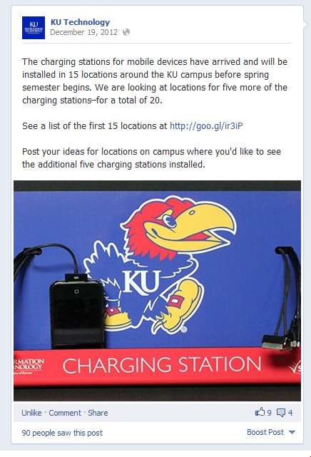
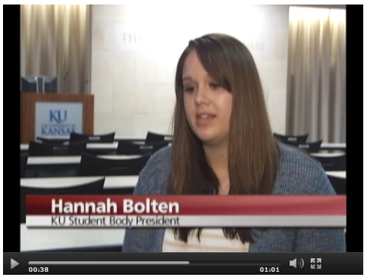
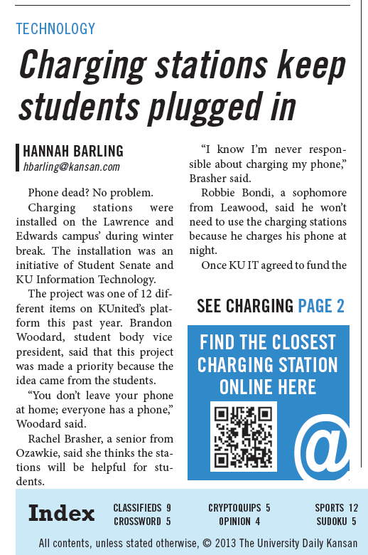
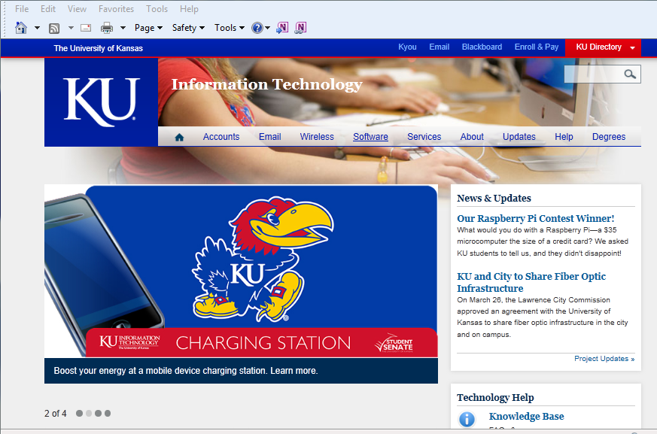
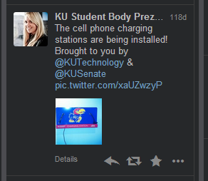
Communications
Notes:
Posted announcement and locations on KU IT website, including a “slideshow image”
Local News Story Posted on Facebook
Tweets by KU IT and Student Leaders
UDK
We made sure to involve student leaders in the outreach efforts, through both traditional media and social media.
Great PR for us!

Slide 15
Feedback on Facebook
Cooper: I would say for the charging stations that it would be great to include iphone 5 capability, if you're going to the extend of providing all of the adapters at said charging stations. Like · · January 28 at 10:34pm
KU Technology likes this.
KU Technology Thanks for the feedback, Cooper. All current charging stations include the iPhone 5 cable, and the stations can be easily adapted to accommodate future cable configurations.
“I actually used one of the phone charging stations today. Thanks for those, KU.” -Anonymous post in the University Daily Kansan
Notes:
May or may not include this

Slide 16
Local News Video

Slide 17
Questions?
Please contact Anne Madden Johnson (amjohnson@ku.edu)
Or
Chuck LaPointe
(clapoint@ku.edu)

