Slide 1
Moving Toward the Cloud
Migration of a 6-college Consortium Data Center to a Virtual Hosted Platform
Jerry Smith & Russ Francis
Associated Colleges of Central Kansas

Slide 2
Our Session Will Consider:
An introduction to ACCK
The needs assessment that lead ACCK to consider a hosted infrastructure
How we built our business case and determined ROI for the project
Negotiating the services contract and building the project plan
Our migration experiences
Changes driven by the move to a hosted infrastructure and cloud services
Current status and future considerations
An opportunity to share experiences

Slide 3
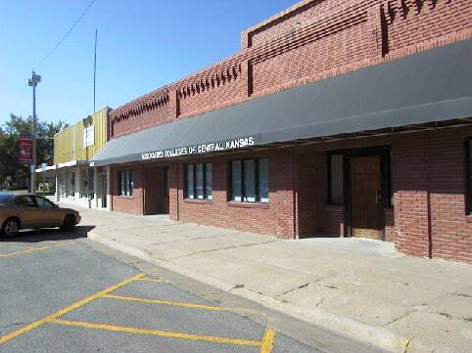
An Introduction To ACCK
The Associated Colleges of Central Kansas (ACCK) is a consortium of six private colleges located within 40 miles of McPherson, Kansas. Over 4,000 students are enrolled. They are served by faculty and staff of over 800.

Slide 4
ACCK Members Since 1966
Bethany College
Lindsborg, KS 67456
785-227-3311 www.bethanylb.edu
McPherson College
McPherson, KS 67460
620-241-073
www.mcpherson.edu
Bethel College
North Newton, KS 67117
316-283-2500
www.bethelks.edu
Sterling College
Sterling, KS 67579
620-278-2173
www.sterling.edu
Kansas Wesleyan Univ.
Salina, KS 67401
785-827-5541
www.kwu.edu
Tabor College
Hillsboro, KS 67063
620-947-3121
www.tabor.edu

Slide 5
ACCK Mission
The Associated Colleges of Central Kansas is established:
To be a voluntary association of church-related colleges in close geographical proximity that represents value-oriented, independent higher education;
To benefit each institution through cooperation that provides economy and enrichment of academic programs, yet preserves individual identity through the unique emphasis of each institution;
To encourage international and intercultural programming, thereby expanding the educational opportunities available to the members of each college community;
To enhance collegiality among disciplines and administrative offices and the quality of the academic offerings; and
To provide technical assistance of a range and level of sophistication not possible as six separate institutions.

Slide 6
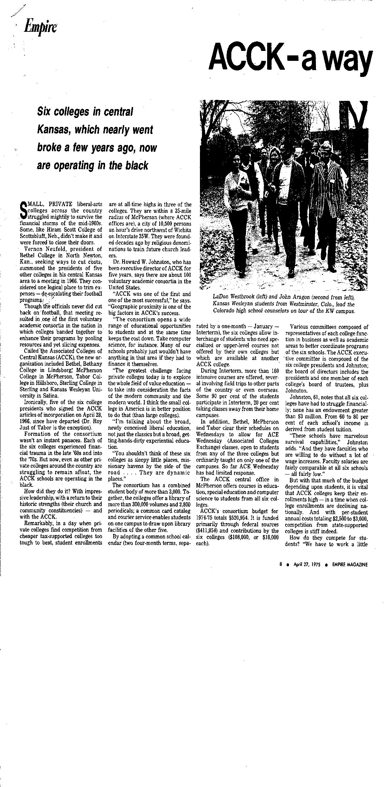
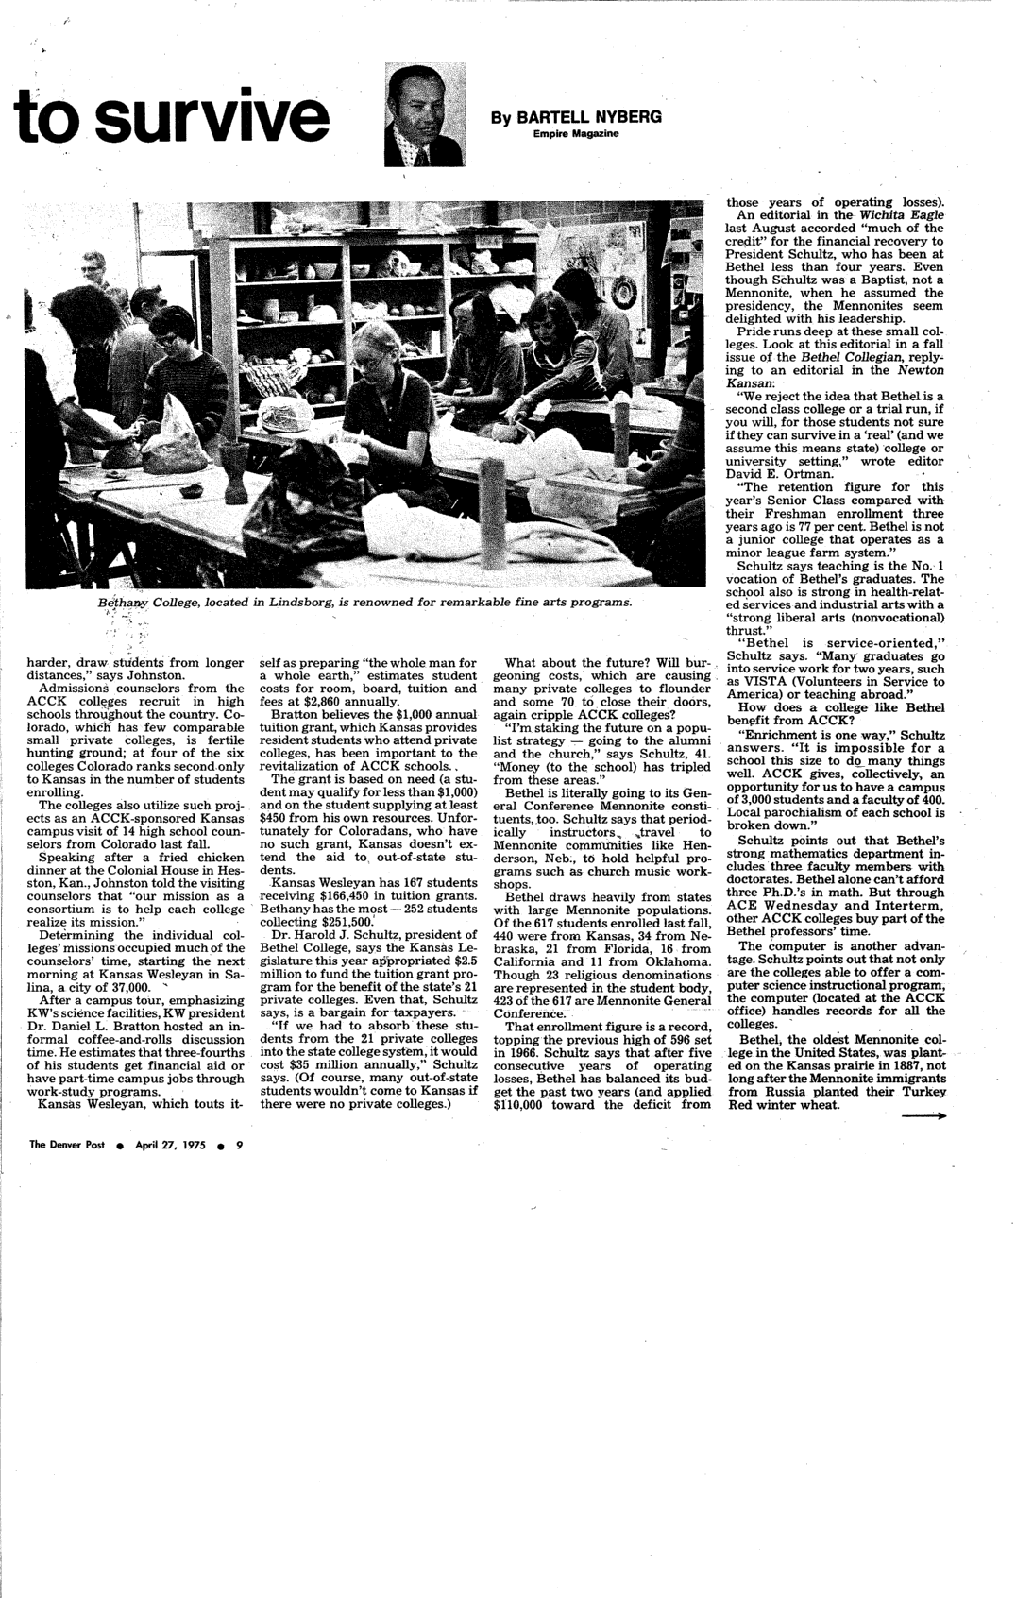
Shared Technology Services
Since 1970 ACCK has been providing shared technology services to the member colleges

Slide 7
ACCK Technology 1966-1976 ACCK into new quarters with new computer system
McPherson Sentinel 5/20/76
The crane is hoisting $200,000 of computer equipment into the new ACCK building at 100 N. Main
“The six colleges will have remote terminals which will connect them to the ACCK computer. . [and] the computer system will be available to all six colleges day and night. .”

Slide 8
Technology Services – Before Migration
ACCK hosts and supports a shared ERP (administrative system) for the 6 member colleges
Jenzabar CX system
Each College has its own database instance (like its own system)
There is shared source code but each college has many customizations and individual configurations of the system
All data is housed and managed by ACCK
ACCK provides Consulting, Training and Help Desk services in support of the ERP
Each College supports its own LAN/WAN and Desktops
Each Campus also has its own campus applications
The ACCK Datacenter hosts the equivalent of approximately 20 servers in a VMware (Windows / Linux) virtual and an HP Unix environment.
Notes:
Russ to address

Slide 9
ERP Modules and Services
The Jenzabar System provides support for all major administrative functions:
Recruiting and Admissions
Registrar (Student Information System)
Housing and Student Life
Business Operations
Learning Management System (e-Racer / Moodle)
Advancement
ACCK provides a range of services and activities supporting the system
Central Help Desk
Liaison to Jenzabar for major problems
Training and Training Coordination
Project management and implementation of upgrades
System administration and DBA functions

Slide 10
ACCK Technology Organization
Valerie McDowell
Senior Programmer/Analyst (Academic Records)
Jesse DeWeese
Programmer/Analyst (Academic Records/LMS)
James Allen
Programmer/Analyst (Advancement/Admissions/Alumni)
Kevin Samuelson
Programmer/Analyst/Trainer (Advancement/Admissions/Alumni)
Russ Francis
Systems Analyst/Programmer (Financial)
Rita Ownbey
Analyst/Trainer (Financial)
Randi Gotti
Analyst/Trainer (Cognos Report Trainer)
The technology center is staffed by seven analysts.
Each analyst is responsible for the support, implementation and training of users in a functional area of the colleges.

Slide 11
Our Challenges – A Needs Assessment
Moving from Burger King to McDonalds – Building Common Best Practices
Rapidly changing software requests – How to respond more quickly
Supporting JX – How do we size the data center
Very limited staff and very hard to increase staff
Growing concerns for business continuity / disaster recovery
Aging Servers – CX UNIX server EOL
Continual Budget Pressure

Slide 12
Identifying Specific Data Center Needs
Hardware Needs
Replace Unix server – Either go to a new HP Unix platform – or convert to Linux.
Update the VM servers – require at least 2 fairly high end servers
Purchase and install a SAN to meet storage requirements
Acquire some type of consolidated back-up system.
Business Continuity Needs
Update Air Conditioning – needed a true computer room system
Update UPS - only 20 minutes storage
Acquire and install a generator
Build some type of offsite “quick recovery” center
With all these needs it was time to consider an alternative solution
Notes:
Russ top
Jerry Bottom

Slide 13
Building the Business Case for Hosting (Simplified estimated costs for a three year period)
Hosted Infrastructure
In House Data Center
2 Servers for VM $40K
New Unix Server $30K
SAN + initial disk $40K
Backup System $10K
3-year maint. $54K
AC upgrade $20K
UPS upgrade $10K
Generator $30K
3-year main $18K
1 FTE Systems Admin $195K
Total $447K
Hosting services $246K
Convert Unix to Linux $ 15K
Migration Services $ 20K
New Licenses $ 10K
Sys Admin. Services $ 50K
Enhanced Backup $ 13K
Total $354K
Three-Year estimated savings of $93K

Slide 14
Business Case Notes
ACCK has in place a contract with Jenzabar for CX/JX maintenance and a pool of consulting hours that co-terminates with the hosting services contract.
In our model, the cost of the consulting services has a $10K (about 10%) cost of growing services. Keep in mind, one adds hosting services as they are required - there is no reason to pay for capacity until it is needed. Thus hosting is more of a “just in time” model, whereas typical in house planning would normally include buying extra capacity.
We have added optional back-up services that includes extended backup retention and a once per month tape that is sent to our location for storage (Audit copy).
The SLA for hosting guarantees no less than 99.50 uptime – It would be very hard for us to reach that level with our in house data center.
Notes:
Russ Bottom

Slide 15
Planning the Migration
Jenzabar conducted and sized the replacement virtual infrastructure.
The virtual infrastructure configuration included:
1-Linux Servers for Informix and CX applications, 2 virtual CPUs, 8GB RAM, 200GB disk space each
8-IIS Servers 1 V-CPU, 4 GB RAM, 50 GB disk space each.
2- SQL Servers (1 V-CPU, 4 GB RAM, 50 GB disk space each
3- RDS Servers (1 V-CPU, 4 GB RAM, 50 GB disk space
1-COGNOS Dispatch server (1 V-CPU, 8 GB RAM, 50 GB disk space
1-COGNOS Content server (1 V-CPU, 8 GB RAM, 50 GB disk space
6 Mbps Internet bandwidth
Notes:
Russ

Slide 16
Virtual Infrastructure Configuration (cont.)
Virtual hosting included the following:
Backup and storage up to 25 GB per server
DB and Transaction log backups
Virtual server backups for each server
Backup to tape and storage (cost of tapes not included)
Firewall
Web Virus, Content and Spyware protection
Disaster Recovery
Failover virtualization server access
Notes:
Russ

Slide 17
Simplified ACCK Network Configuration
JICS Server 1 per College, ACCK, Test
CX Linux Servers & Supporting Databases
Internet
CX
VPN
CX
VPN
ACCK
Office
Bethany
College
Bethel
College
Kansas
Wesleyan
Univ.
McPherson
College
Sterling
College
Tabor
College
JICS
JICS
Internet

Slide 18
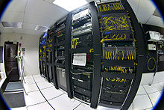
Virtual Infrastructure Configuration (cont.)
Environment Management
Located in a Tier 4 data center
SAS 70 Compliant
99.5% infrastructure uptime
Management / Administration of the virtual infrastructure
Management / Administration of the SAN fabric
24 X 7 monitoring of the virtual infrastructure
24 X 7 support of the virtual infrastructure
Note: We already had in place a pool of consulting hours from Jenzabar to use for SMO installations and general assistance.
Notes:
Jerry

Slide 19
Planning The Migration (cont.)
Building the Project Plan
The contracts were signed in July and project planning began in August.
To build the project plan a team was assembled of the ACCK Staff, Jenzabar /Project Management, Campus EAI (subcontractor) and each of the ACCK Colleges’ IT Directors.
The Plan was scheduled backwards – starting with a desired cut-over at the end of December.
The Plan was broken down in 7 Phases of activities:
Project Contracts and Approvals
Remote Server Deployment
JICS and JICS Server Setup
Linux Migration
Cutover
Post Cutover Analysis and Adjustments
On-Going Maintenance Procedures Established

Slide 20
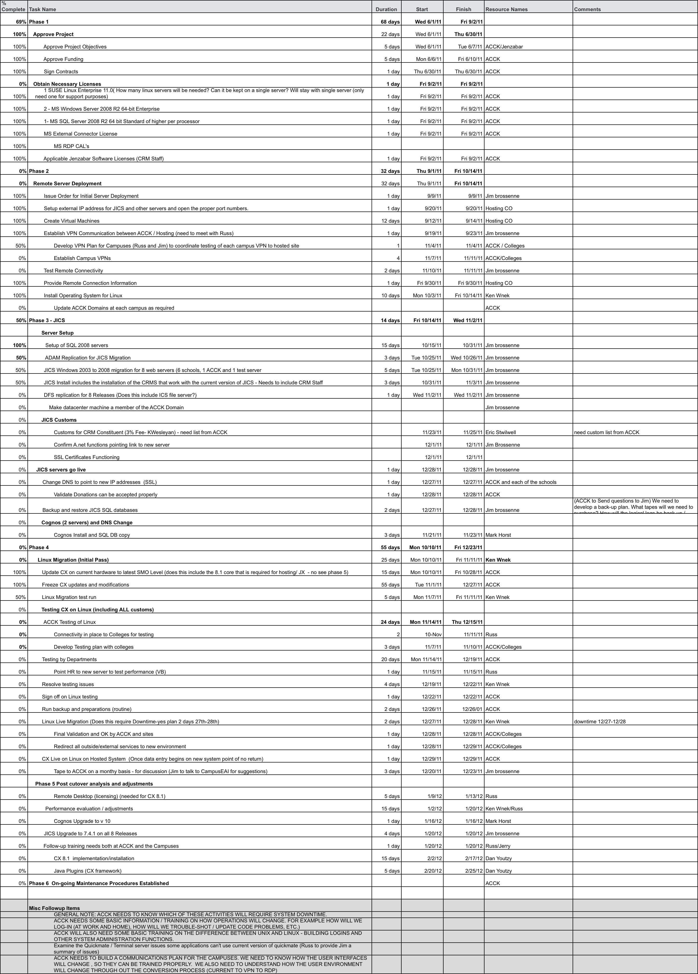
Simplified
Project Plan

Slide 21
The Migration Experience
The Migration started in September and for the most part was completed by mid-January.
While there were bugs that caused some functionality issues, end users only experienced 2-4 Days of downtime (Mostly December 27 -31).
Jenzabar / Campus EAI built the virtual platform with very little assistance from ACCK (a very nice benefit).
The Unix to Linux conversion went much better than expected – although we still discover a minor issue from time to time.
The migration of the Data to the virtual platform went very well – although our original “Code Freeze” concept did not work.
The major issues were related to network changes. Establishing the 7 VPNs required to connect the colleges to the hosting center ended up being the most challenging part of the project.
Notes:
Russ

Slide 22
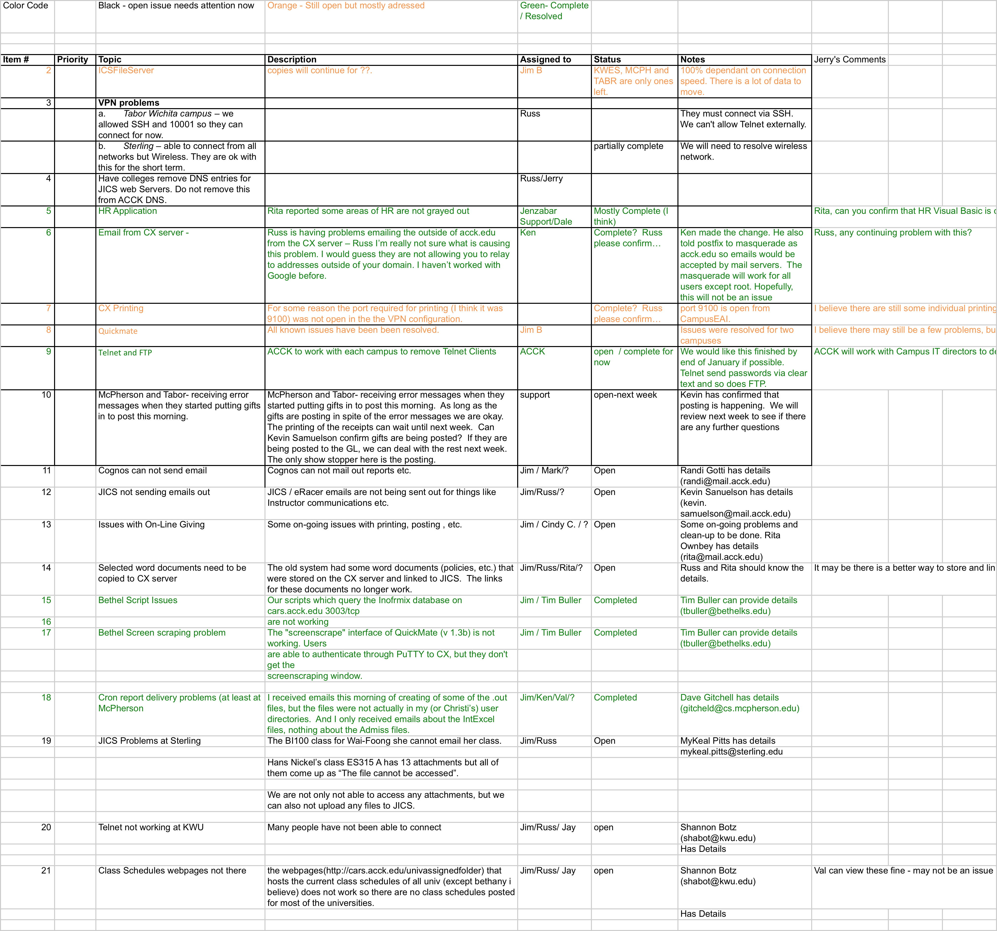
Sample
Issues
List

Slide 23
The Current Status of the Project
We are now moving into Phase 6 (On-Going Maintenance) of the project.
We are still having a few network related issues – primarily occasional end user disconnects.
Mixing router and firewall vendors should probably be avoided.
The Jenzabar clients seem to be more “picky” with VPN functionality.
We are still fixing some differences between Unix and Linux.
For the most part system performance has improved although we are still investigating a couple of applications that experience slowness from time to time.
We have not had any major hosted system downtime since cutover.
Currently setting up extended back up services.
It’s nice to sleep through thunderstorms.
Notes:
Jerry / Russ

Slide 24
Future Plans and Considerations
We are looking at some systems administration options:
Log monitoring
System tuning
Database and OS upgrades
Working with Jenzabar to see what it would take to fill in our service gaps.
The goal is to build a package of services that can be as turnkey as possible - kind of a “Build it yourself” SAS model.
Considering some other applications that might be hosted on the infrastructure – We can buy other capacity from a discounted price list.
Looking to track capacity and cost to see how close reality tracks to our business case.

Slide 25
Some Things We Learned
Virtual Infrastructure / Cloud Computing changes the role of IT and the IT staff.
The staff moves from a technical focus to a vendor management focus.
Requires working through others to get things done
Can sometimes be frustrating because you can’t just do it yourself
Relationship building (both formal and informal) is critical – You must know who to go to to get the job done.
Need to learn the key people in each of the vendor functional areas
The relationship must also extend to the subcontractors
Your success is based on the success of the extended team
Try to reduce the differences in equipment as much as possible
If possible use the same manufacture for firewalls and routers as the data center uses.

Slide 26
Conclusions
While we are still early in the three year arrangement – All indicators show that we made the right choice for us.
The small to medium sized college may be the “sweet-spot” for Hosted Infrastructure related cloud computing.
Too large to just have a simple data center
Too small to have the scale and specialized staff to build a data center with the capacity and redundancy the college needs
The business continuity capabilities of a Tier 4 datacenter alone may well offset any cost differentials.
It is highly likely that “logical multi-tenancy, packaged, virtual private cloud” as Gartner calls this type of service, will become very common in the near future. Now may be the time to “Move Toward the Clouds”.

Slide 27
Questions and Discussion
What kind of experiences have you had with hosting services or hosted Infrastructure?
Where do you think the future is headed?
What are the issues to consider?
Contact Information
Jerry Smith jerry.smith@mail.acck.edu
Russ Francis russ@mail.acck.edu
Associated Colleges of Central Kansas
210 South Main Street
McPherson, Kansas 67460
Telephone: 620 241-5150

